Slide 1
TITLE: REAL TIME SPEECH TRANSLATOR (USING PYTHON )
TEAM MEMBERS:
2010030475- Siddharth sri sai
2010030313-navadeep reddy
2010030502-vipul reddy
2010030503-manoj

Slide 2


Table of Contents
ABSTRACT
Project Area
Literature Survey
Conclusion
PREFFERED LINKS
Thank you

Slide 3
PROJECT TITLE AND PROJECT AREA
REAL TIME
MULTI-LINGUAL VOICE TRANSLATOR
NATURAL LANGUAGE PROCESSING

Slide 4
PROBLEM STATEMENT
TRASLATION OF SPEECH FROM ONE LANGUAGE TO MULTIPLE LANGUAGES

Slide 5

ABSTRACT:
In today’s world language translation is very important, because if any person attends a global meeting/conference the language might be different from what is known, at that time speech translation is very useful. Speech translator is mediator between two languages. In this we have reviews various issues related to Speech translation as well as various difficulties in it. The purpose of this paper is to develop a speech translator that can recognize initial language spoken and can translate from one language to other languages sentence by sentence.

Slide 6

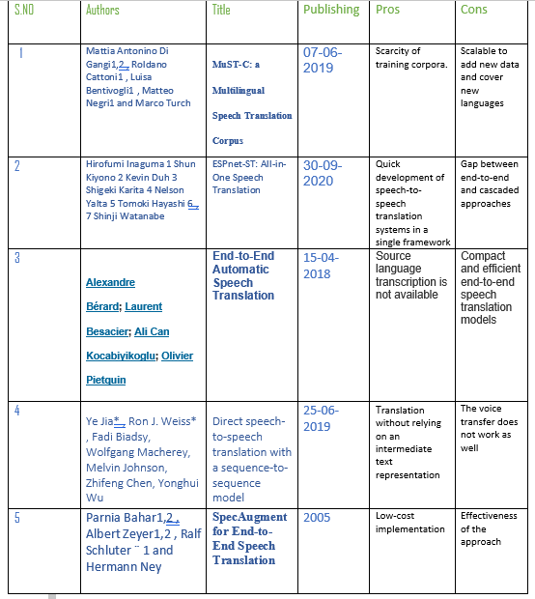
LITERATURE SURVEY

Slide 7
Literature survey
The Voice/speech translation system integrates two technologies : Automatic Speech Recognition, Machine Translation. The speaker of language A speaks, and the speech recognizer recognizes the utterance. The input is then converted into a string of words, using dictionary and grammar of language A, by using the massive corpus of text of language A.
HMMs are mostly used in speaker recognition today. We get the output sequence of symbols from these models. HMMs are used in speech recognition because the audio signal can be considered piece wise stationary signal.
Neural Networks has come up as nice approach for acoustic modelling in ASR since 1980s. In contract to HMMs, neural networks does not make any assumptions regarding the statistical properties and have several qualities that make them great model for speech recognition.

Slide 8
LITERATURE SURVEY
Most of the data that we find is from different domains. For example, the texts that are used in the chat rooms are different than those used in the parliaments. The problem in the Neural machine translation can be that it is trained on the data that is not at relevant to the user and hence not getting correct translations. This problem is called as Domain Adaptation.
Speech translation is conventionally carried out by cascading an Automatic Speech Recognition System and Machine Translation system. Generally, the factors that are optimized are the language models and the acoustic models along with the word error rate for the ASR system and the BLEU score for the MT system.

Slide 9
Humans can interact with each other through natural language. If both people understood their languages, then interaction between these two people is more complete. In this Speech translation system, there is no need of creation of database manually for matching/converting source text to destination text, due to this translation time will be reduced. From the comparison between techniques in speech recognition, Sphinx model is identified as one of the popular connectionist techniques and suitable to use in speech recognition. We plan to develop a multi-way translation like Hindi to English, Tamil and Telugu. Finally, the Real time voice translation system is done in this way.
Conclusion:

Slide 10
Preferred Links :
Create a real time voice translator using Python - GeeksforGeeks
Building a Speech Translator in Python | by Behic Guven | Towards Data Science

Slide 11

Suggestions

Slide 12
THANK YOU

